Slide 1

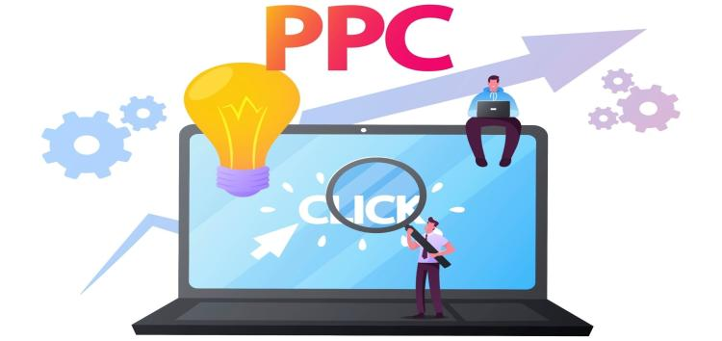
PPC Consultant
By: The Digital Education

Slide 2
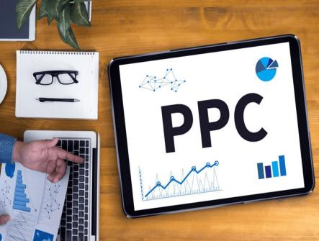
What Is a ppc Consultant?
A PPC consultant or a pay per click consultant is an expert who specializes in handling and optimizing PPC advertisement drives for companies. PPC is a digital marketing model where advertisers pay a price each time their ad is clicked. Standard PPC mediums include Bing Ads, Google Ads, and social media advertisement platforms like Facebook Ads and LinkedIn Ads.

Slide 3
Job And Responsibilities Of PPC Consultants
Develop A PPC Campaign Strategy
Keyword Research
Landing Page Design
Create, Modify, and Optimize Ad Campaigns
Budget Management
Bid Management
Performance Analysis
A/B Testing
Audience Targeting
Report on Campaign Performance
Identify and Execute on CRO Opportunities
Manage Client Relationships
Communicate with Team Members

Slide 4
Skills Required For PPC Consultants
Ad Copywriting
Creativity and Research Skills
Knowledge of Advertising Networks
Knowledge of Paid Social Networks
Account-Based Marketing
Client Relationship Management
Platform Proficiency
Analytical Tools Skills
Strategic Thinking
Attention to Detail and Learning Agility
Budget Management
Data Analysis and Reporting
Conversion Rate Optimization (CRO) Knowledge
Leadership Skills and Professionalism

Slide 5
Services Offered By PPC Consultants
Campaigns Setup
Keyword Research and Selection
Ad Copywriting and Creative Development
Ad Extension Implementation
Campaign Optimization
Remarketing and Retargeting
Conversion Tracking Setup
Performance Analysis and Reporting
Campaign Expansion and Scaling
Budget Allocation and Forecasting
Consultation and Strategy Development
Ad Compliance and Policy Adherence
Training and Education

Slide 6
Why Do You Need A PPC Consultant
Understand All the Platforms
PPC Consultants Have the Knowledge of the Right Tools
PPC Consultant Will Monitor Your Campaign
Full Research of Consumers, Keywords, and Competitors
Performance on Your Other Paid Channels Has Plateaued
Your Budget Changed Significantly
Thoughtful Budget Allocation
Iterative, Quick Strategy Adjustments

Slide 7
How To Choose The Best PPC Consultant
For Your Brand
Experience in Driving Results
Check Knowledge About PPC Best Practices and Tools
Diverse Client Portfolio
Read Testimonials and Case Studies
Verify Credentials

Slide 8
How To Measure The ROI Of PPC Consulting Services?
Monitor the KPIs
- Average Click-Through Rate (CTR)
- Quality Score of Your Ad Content
- Impression Share
- Average Cost-Per-Click (CPC)
- Cost for Action/Cost Per Conversion
- Average Position of Your Ad
- Conversion Rate

Slide 9


