Slide 1


Google Ads Consultant
By: The Digital Education

Slide 2
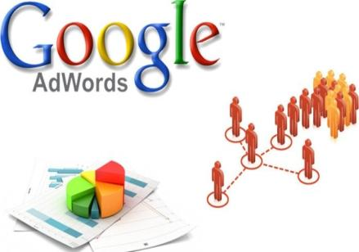
What Is a Google ADS Consultant?
A Google Ads Consultant is an expert who specializes in delivering expertise and advice on Google Ads, which is Google's online advertising medium. Google Ads permits companies to develop and run ads that are visible on Google's search engine and other Google platforms.

Slide 3
Job And Responsibilities Of Google Ads Consultants
Campaign Strategy Development
Keyword Research and Selection
Ad Copywriting and Creative Development Suggestion
Campaign Setup and Management
Performance Monitoring and Analysis
Conversion Tracking and Optimization
Advising on Industry Trends and Best Practices
Report on Campaign Performance

Slide 4
Skills Required For Google Ads Consultants
Google Ads Platform Proficiency
Analytical Tool Skills
Keyword Research and Selection
Ad Copywriting and Creative Skills
Conversion Tracking and Optimization
Budget Management
Stay Updated with Industry Trends
Communication and Client Management
Attention to Detail and Learning Agility
Leadership Skills and Professionalism

Slide 5
Services Offered By Google Ads Consultants
Google Ads Campaign Budget Analysis
Keyword Research and Planning
Paid Campaign Analysis & Implementation
Competitor Ads Review
Landing Page Creation and Optimization
Google Ad Copy Creation & Testing
Conversion Rate Optimization & Analytics
Ongoing Bid Adjustments
Monthly & Real-time In-Depth Reporting

Slide 6
Benefits Of A Google Ads Consultant
Extensive Knowledge and Experience
Results-Oriented
Creates Advertising Strategies
Constantly Monitors and Optimizes Campaigns
Highly Proficient in Technical Aspects of Google
Data-Driven Approaches
Keeping Up with Trends
Cost-Effective Solutions

Slide 7
How To Bid For Google Ads
Clicks - Opt for the Manual CPC (Cost-Per-Click) bidding strategy.
Regularly observe your campaign's performance to provide your bids align with your funding and objectives.
Impressions - Set your maximum CPM bid, representing the amount you're willing to pay for 1,000 ad impressions.
Ensure your ad creative and targeting are optimized to maximize visibility.
Conversions - Opt for the Target CPA (Cost-Per-Acquisition) bidding strategy.
Set your target CPA, which is the average amount you're willing to pay for each conversion.
Consider enabling Enhanced CPC to allow Google Ads to adjust your bids in real time based on t he likelihood of conversion.
Video Ad Views - Set your maximum CPM bid for video ad views.
Ensure your video content is engaging and relevant to your target audience.
Monitor view rates and adjust bids based on the performance of your video ads.

Slide 8
How To Choose The Best Google Ads Consultant
For Your Brand
Google AdWords Certification
Experience in Driving Results
Check Knowledge About Google Ads Practices and Tools
Diverse Client Portfolio
Read Testimonials and Case Studies
Verify Credentials

Slide 9


