Slide 1

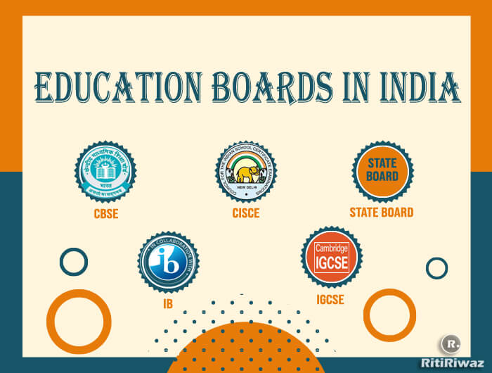
Toughest Board In India
By: The Digital Education

Slide 2
National Level Boards in India
Central Board of Secondary Education (CBSE)
Indian Certificate of Secondary Education (ICSE)
National Institute of Open Schooling (NIOS)
Council for the Indian School Certificate Examinations (CISCE)
National Council of Educational Research and Training (NCERT)
National Board of Examinations (NBE)
National Council for Vocational Training (NCVT)
National Council for Teacher Education (NCTE)

Slide 3
State Level Boards in India
Maharashtra State Board of Secondary and Higher Secondary Education (MSBSHSE)
Board of Secondary Education, Rajasthan (RBSE)
Karnataka Secondary Education Examination Board (KSEEB)
West Bengal Board of Secondary Education (WBBSE)
Tamil Nadu State Board of School Examination (TNBSE)
Telangana State Board of Intermediate Education (TSBIE)
Gujarat Secondary and Higher Secondary Education Board (GSHSEB)
Punjab School Education Board (PSEB)

Slide 4
Which is the Toughest Board in India
CBSE
CBSE is one of the most widely recognized boards in India. It is known for its structured curriculum and standardized assessments.
ICSE
ICSE is often considered academically rigorous, with an emphasis on in-depth subject knowledge and holistic development.
State Boards
State boards have their own unique challenges and These boards can be demanding due to their regional language medium, making them tougher for non-native speakers.

Slide 5
Pros and Cons Of National Level Boards in India
Pros | Cons
Uniform Curriculum | Rote Learning
Recognition | High Competition
Competitive Exams Preparation | Limited Regional Relevance
Holistic Approach | Less Flexibility

Slide 6
Pros and Cons Of State Level Boards in India
Pros | Cons
Regional Relevance | Lack of Uniformity
Language Options | Limited Recognition
Less Stress | Less Exposure
Inclusive | Professional Courses

Slide 7

By: The Digital Education

