Slide 1

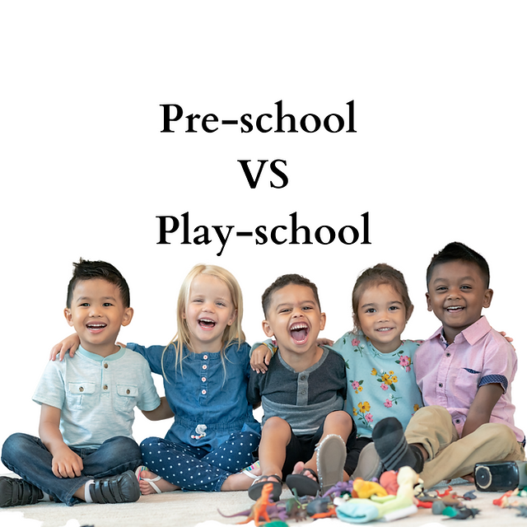
Preschool vs Playschool
By: The Digital Education

Slide 2

Introduction of Preschool
Pre Schools are set up with a goal of early childhood development, which offers a structured curriculum with a focus on academic readiness preparing the children of the age group 3-5. Not just nurturing early minds, the pre school leans towards the early academic phase of a child

Slide 3

Introduction of Playschool
Play School offers the children an environment where they play, and develop through socializing. It is meant for the children of the age group 2-5 for their structural development. It has a less formal set up and motivates creative and social learning processes

Slide 4
Importance and Benefits of Preschool and Playschool
Early Learning
Socialization
Emotional Development
Cognitive Development
Independent and Confidence
Language Development
Preparing for Formal Education
Routine and Discipline
School Readiness

Slide 5
Variables should be considered while choosing a Preschool or Playschool
Philosophy and Approach
Age group
Location
Reputation and Reviews
Duration
Class Size and Student Teacher Ratio
Safety and cleanliness
Facilities and Resources
Parent Involvement
Cost and Financial aid

Slide 6
Teaching methods and techniques used in preschool or Playschool
Use of symbols and logos
Naming and matching activities
Gardening
Play-based learning
Child-centred approach
Art and creativity
Music and movement
Outdoor play
Parent involvement
Positive Reinforcement
Group Activities
Fine motor skills
Early Literacy and Numeracy

Slide 7


