Slide 1

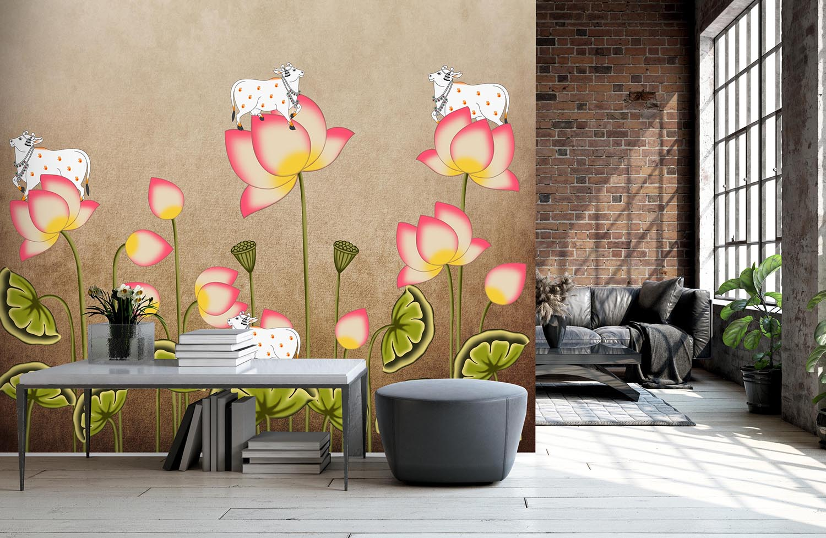
Pichwai Painting
Wallpapers
By: The Digital Education

Slide 2
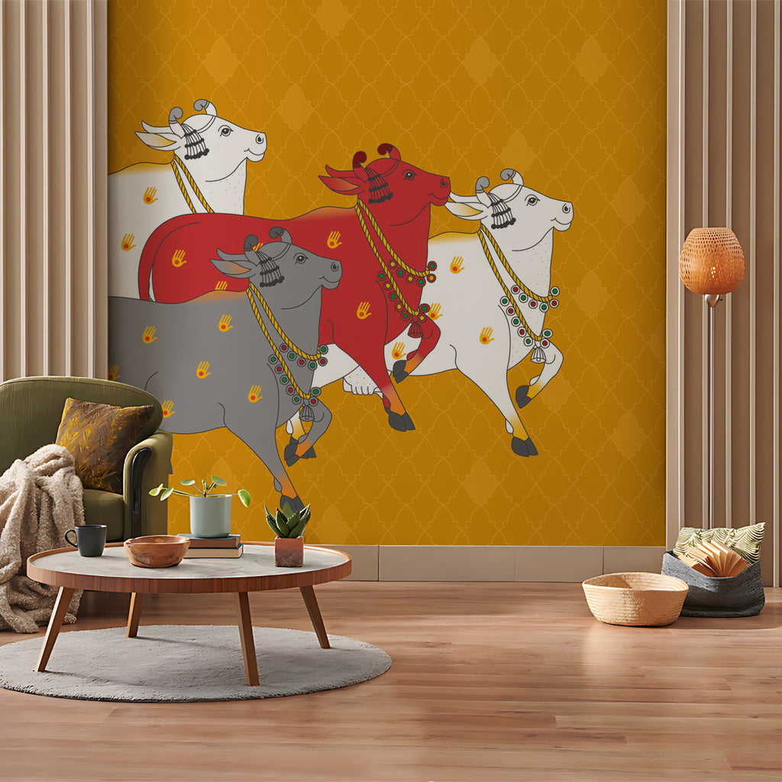
About Pichwai Wallpaper
A Pichwai wallpaper typically refers to a digital image or background that features the visual elements of gokul Pichwai paintings. These wallpapers are designed to be used on computer screens, smartphones, or other digital devices, bringing the intricate and vibrant aesthetics of Pichwai art into the digital realm.

Slide 3
Things To Keep In Mind Before Purchasing Pichwai Wallpaper
Size and Space
Colour Scheme/Matching Decor
Quality and Material
Cultural Sensitivity
Wallpaper Shelf life

Slide 4
Why Choose Pichwai Wallpaper ?
Cultural Aesthetic
Vibrant and Stunning
Unique and Artistic
Positive Energy
Storytelling
Easy Maintenance

Slide 5
How To Apply Pichwai Wallpaper?
Surface Preparation
Glue Application
Wallpaper Application
Smoothening

Slide 6
How To Care for Pichwai Wallpaper?
Regular Dusting
Gentle Cleaning
Avoid Direct Sunlight
Monitor for Insects
Protect from Moisture
Clean Spills Promptly

Slide 7


