Slide 1

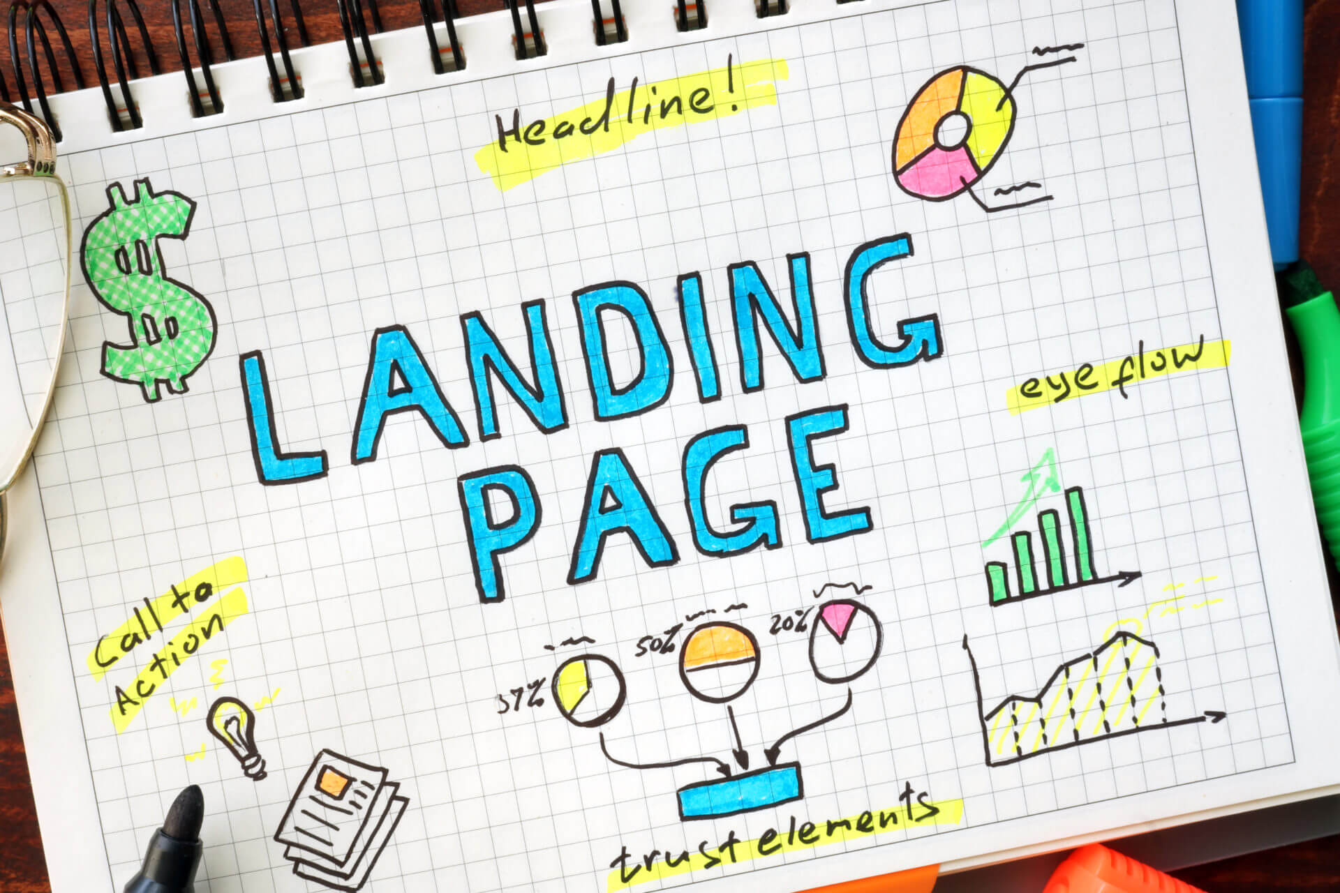
Which attributes describe a good landing page experience?
By: The Digital Education

Slide 2
What is a Good Landing Page Experience?
The concept of landing page understanding revolves around evaluating the extent to which a user clicking on your advertisement finds your landing page valuable and relevant.
It plays a crucial role in the optimization of marketing campaigns, particularly in the domain of search marketing.
In the world of pay-per-click (PPC) advertising, the landing page experience serves as an essential meter for determining how valuable and appropriate your landing page is to users who click on your Google ads.

Slide 3
Attributes For Good Landing Page Experience
Clear and optimized content
Relevant visuals
Easy to Navigate
Fast page loading times
Design and layout
A compelling call to action
Mobile responsiveness

Slide 4
Attributes Don’t Describe a Good Landing Page
Unnecessary elements
Navigation to other pages
Advertisements
Complicated forms

Slide 5

By: The Digital Education

