Slide 1

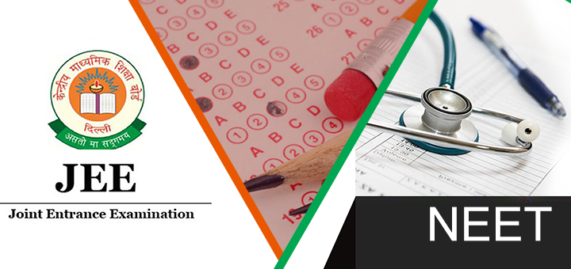
What is JEE And NEET ?
By: The Digital Education

Slide 2

Overview of JEE
National Testing Agency's (NTA's) JEE Main exam in order to be admitted to prestigious colleges and universities like the Indian Institutes of Technology (IITs), National Institutes of Technology (NITs), and other top engineering schools

Slide 3
Syllabus
Chemistry:
Physical Chemistry: Atomic structure, chemical bonding, thermodynamics, chemical equilibrium, electrochemistry, chemical kinetics.
Inorganic Chemistry: Periodic table, chemical bonding, coordination compounds, metallurgy.
Organic Chemistry: General organic chemistry, hydrocarbons, organic compounds containing oxygen and nitrogen, polymers, biomolecules.
Mathematics:
Algebra: Quadratic equations, sequences and series, complex numbers, matrices, determinants.
Trigonometry: Trigonometric identities, equations, properties of triangles.
Calculus: Limits, continuity, differentiability, integration, differential equations.
Coordinate Geometry: Straight lines, circles, conic sections.
Geometry: 2D and 3D geometry, vectors, statistics, probability.
The syllabus for the JEE exam is vast and covers topics in physics, chemistry, and mathematics. Here is a detailed overview:
Physics:
Mechanics: Laws of motion, kinematics, work-energy theorem, rotational motion, gravitation.
Thermodynamics: Laws of thermodynamics, heat transfer, kinetic theory of gasses.
Electromagnetism: Electrostatics, current electricity, magnetic effects of current, electromagnetic induction.
Optics: Ray optics, wave optics.
Modern Physics: Dual nature of matter and radiation, atomic and nuclear physics.

Slide 4
Eligibility Criteria
Age Limit
There's no particular age restriction for JEE Main. In any case, for JEE Advanced, candidates must be born on or after October 1, 1999 (for the 2024 exam)
Scholastic Capabilities
For JEE Main: Candidates must have completed their 10+2 or comparable examination from a recognized board.
Attempts
Qualifying Marks
Candidates must meet the least qualifying marks in their 10+2 or comparable examination as indicated by the particular sheets.
Subject Combination
For JEE Main, candidates ought to have studied Physics and Mathematics along with Chemistry or Biology. For JEE Advanced, Physics, Chemistry, and Mathematics are obligatory.
For JEE Advanced: Only those who have successfully cleared JEE Main and are in the best 2,50,000 rankers are qualified.
Candidates can attempt JEE Main for three consecutive years. However, there's a limit to the number of attempts for JEE Advanced, which is ordinarily two attempts in two successive years.

Slide 5

Overview of NEET
National Entrance Eligibility Test (UG) is the new qualifying entrance exam notified under “Higher Medical Education Regulations, 1997 and BDS Course Regulations, 2007” by the Council of India.
NEET is recommended for:
Undergraduate Medical Courses (NEET-UG) like MBBS, BDS, etc.
Postgraduate medical courses (NEET-PG) like MS, MD, etc.

Slide 6
Syllabus
Chemistry:
Physical Chemistry: Atomic structure, chemical bonding, thermodynamics, chemical equilibrium, electrochemistry, chemical kinetics.
Inorganic Chemistry: Classification of elements, periodic table, p-block elements, d and f-block elements, coordination compounds, metallurgy.
Organic Chemistry: Basics of organic chemistry, hydrocarbons, organic compounds containing oxygen and nitrogen, biomolecules, polymers, chemistry in everyday life.
Biology:
Botany: Cell biology, plant physiology, genetics and evolution, diversity in the living world, structural organization in plants and animals.
Zoology: Human physiology, reproduction, ecology and environment, biology and human welfare, biotechnology, genetics, and evolution.
The NEET syllabus covers three main subjects: Physics, Chemistry, and Biology (Botany and Zoology). Here's a detailed overview:
Physics:
Mechanics: Laws of motion, kinematics, work-energy theorem, rotational motion, gravitation.
Thermodynamics: Laws of thermodynamics, heat transfer, kinetic theory of gasses.
Electromagnetism: Electrostatics, current electricity, magnetic effects of current, electromagnetic induction.
Optics: Ray optics, wave optics.
Modern Physics: Dual nature of matter and radiation, atoms and nuclei, electronic devices.

Slide 7
Eligibility Criteria
Age Limit
Candidates must be at least 17 years old as of December 31 of the year of admission. There's no upper age limit.
Academic Qualifications
Candidates must have completed their 10+2 or equivalent examination from a recognized board. They must have studied Physics, Chemistry, Biology/Biotechnology, and English as compulsory subjects in their qualifying examination.
Minimum Marks
Common category candidates must score at least 50% marks in their qualifying examination, whereas reserved category (SC/ST/OBC) candidates must score at least 40% marks.
Number of Attempts
There's no constraints on the number of attempts for NEET, as long as candidates meet the age and other qualification criteria.
Nationality
Indian nationals, as well as Non-Resident Indians (NRIs), Overseas Citizens of India (OCIs), Persons of Indian Origin (PIOs), and foreign nationals, are qualified to appear for NEET.

Slide 8

By: The Digital Education

