Slide 1

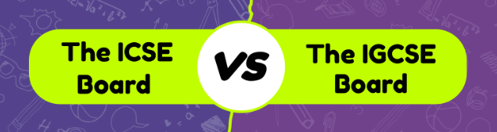
Difference between ICSE and IGCSE
By: The Digital Education

Slide 2
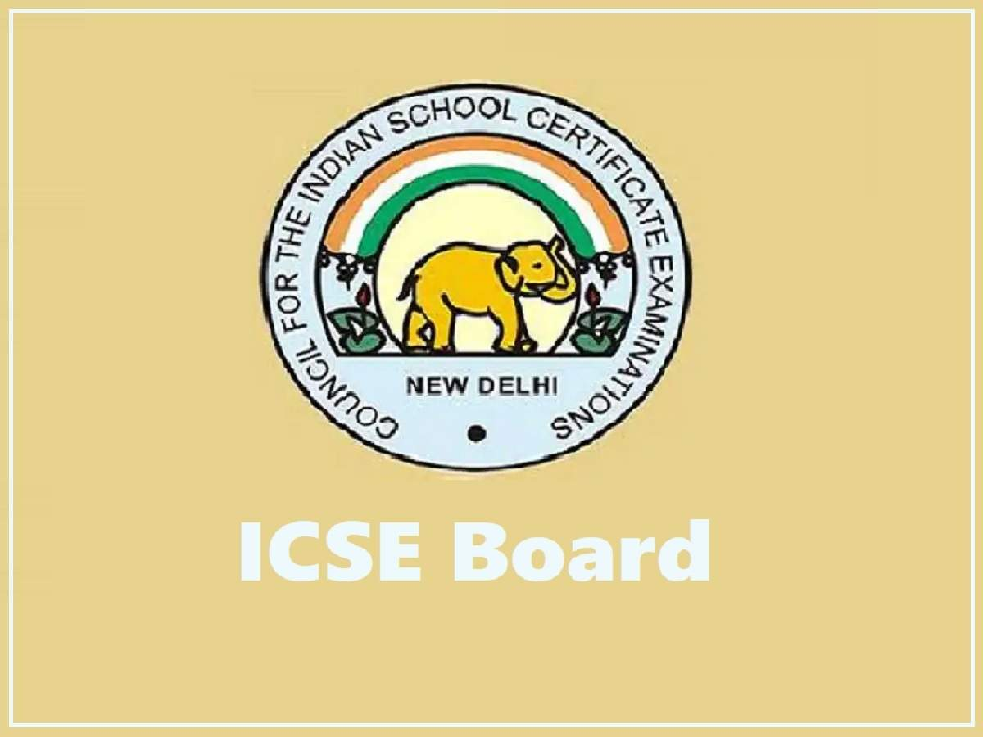
Overview of ICSE Board
The Indian Certificate of Secondary Education (ICSE) is a broadly recognized educational board in India. It conducts exams for students in 10th and 12th grade, emphasizing a comprehensive educational module that joins English and a variety of subjects

Slide 3
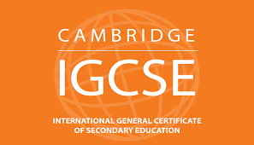
Overview of IGCSE Board
International General Certificate of Secondary Education is a globally recognized educational program offered by Cambridge University. It gives a well-rounded curriculum for understudies around the 14-16 age group, focusing on a wide range of subjects

Slide 4
Key Differences Between CBSE And ICSE Board
Factor | ICSE | IGCSE
Curriculum | ICSE follows a curriculum planned by the Council for the Indian School Certificate Examinations (CISCE), which is custom-made to Indian educational needs | IGCSE is developed by the University of Cambridge International Examinations (CIE) and is designed for a worldwide audience
Medium of Instruction | The medium of instruction for most subjects in ICSE is English, making English language proficiency a pivotal aspect of the curriculum | IGCSE too fundamentally employs English as the medium of instruction, but it is more accommodating to non-native English speakers, providing extra support for language improvement
Assessment and Examination | The assessment incorporates both written examinations and coursework assessments, making it a comprehensive assessment system | It combines written examinations and coursework, offering flexibility in choosing the number of subjects and exams
Global Recognition | While ICSE is well-recognized within India, its worldwide acknowledgment is to some degree restricted compared to IGCSE | IGCSE enjoys worldwide acknowledgment and is broadly accepted by colleges and educational institutions around the world. It is particularly popular in international schools
Adaptability | ICSE provides less flexibility in choosing subjects compared to IGCSE. Students frequently have a set of obligatory subjects they must study | IGCSE offers greater flexibility in subject choices, permitting students to tailor their curriculum to their interests and future career objectives

Slide 5
Syllabus of ICSE Board
English: Language and literature components, including grammar, comprehension, and creative writing.
Second Language: Typically includes Hindi, Bengali, French, German, Spanish, or other regional languages.
Mathematics: Algebra, geometry, trigonometry, statistics, and probability.
Science: Physics, Chemistry, and Biology with in-depth coverage of each subject.
History and Civics: Historical events, political systems, and the functioning of governments.
Geography: Physical and political geography, climate, and natural resources.
Computer Science: Introduction to computer concepts, programming languages, and computer applications.
Economics: Basic economic principles, economic development, and current economic issues.
Commercial Studies: Business studies, accounting, and entrepreneurship.
Environmental Education: Awareness of environmental issues and sustainable practices.
Physical Education: Physical fitness, sports, and games.
Art: Drawing, painting, and creative expression.

Slide 6
Syllabus of IGCSE Board
English: Focuses on language skills, reading comprehension, and writing.
Mathematics: Includes topics like algebra, geometry, statistics, and calculus.
Science: Biology, Chemistry, and Physics with an emphasis on practical skills.
Optional Subjects: Students can choose from a wide range of subjects, including but not limited to:
Languages: Such as French, Spanish, Mandarin, or additional English.
Humanities: Geography, History, Economics, and Business Studies.
Creative and Technical Subjects: Art and Design, Music, Design and Technology, and Computer Science.
Social Science: Sociology, Psychology, and Global Perspectives.
Assessment: It includes coursework, practical exams, and written exams

Slide 7

By: The Digital Education

