Slide 1

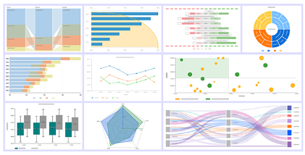
Graphical Representation of Data
By: The Digital Education

Slide 2

What are Graphs and Graphical Representation?
Graphs, in the context of data visualization, are visual representations of data using various graphical elements such as charts, graphs, and diagrams.
Graphical representation of data, often referred to as graphical presentation or simply graphs which plays a crucial role in conveying information effectively.

Slide 3
Principles of Graphical Representation
Clarity
Simplicity
Relevance
Visualization

Slide 4
Rules for Graphical Representation of Data
Select the Right Graph
Label Axes Clearly
Use Appropriate Colours
Include Data Sources
Avoid Misleading Scaling

Slide 5
Importance of Graphical Representation of Data
Enhances Understanding
Helps Decision-Making
Engages the Audience
Universal Language

Slide 6
Advantages of Graphical Representation
Clarity
Efficiency
Memorability
Problem-Solving

Slide 7
Use of Graphical Representations
Business
Science
Education
Journalism

Slide 8
Types of Graphical Representation
Bar Charts
Line Charts
Pie Charts
Scatter Plots
Histograms

Slide 9


