Slide 1

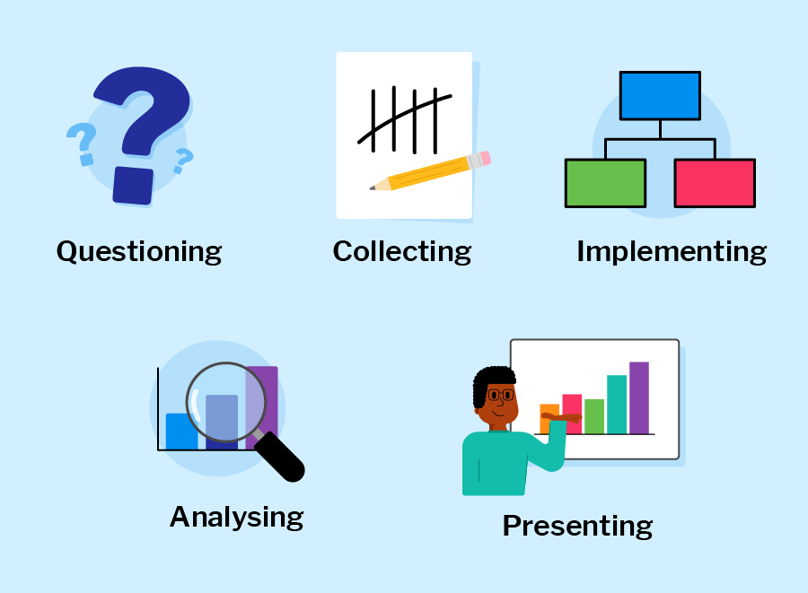
Why Data Handling is Important?
By: The Digital Education

Slide 2
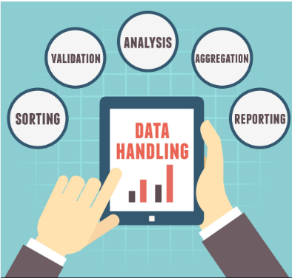
What Is Data Handling?
Data handling can be defined as the meticulous process of managing and manipulating data with the aim of extracting meaningful insights and facilitating well-informed decisions.

Slide 3
Types Of Data
Quantitative Data
Quantitative data represents numerical values that can be measured and counted.
Qualitative Data
Qualitative data consists of non-numerical information, often categorized into distinct groups or qualities.

Slide 4
Types Of Data Handling
Bar Graph
Pictograph
Line Graph
Frequency Distribution
Stem and Leaf Plots
Dot Plots
Cumulative Tabled and Graphs

Slide 5
Importance of Ensuring Accurate and Appropriate Data Collection
Enhances Decision-Making
Quality Insights
Legitimacy
Uses of data handling in daily life
Reputation

Slide 6
Consequences from Improperly Collected Data
Misleading Decisions
Inefficient Problem Solving
Erroneous Insights
Resource Wastage

Slide 7

By: The Digital Education

