Slide 1

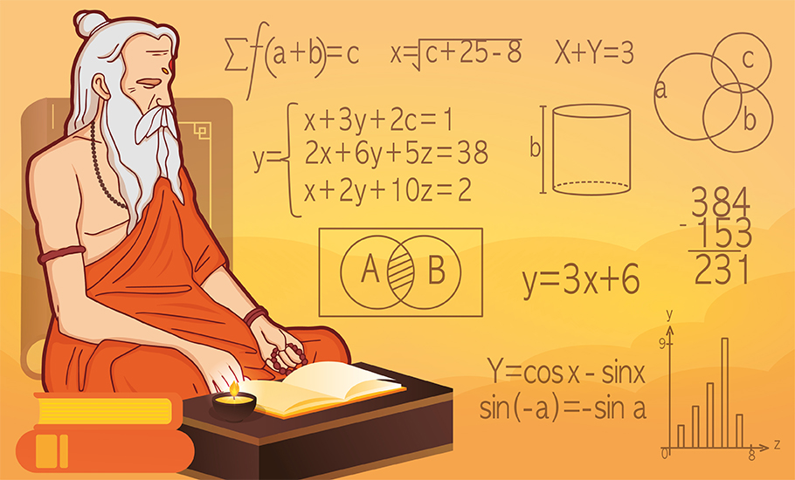

Tricks And Importance of Vedic Maths
By: The Digital Education

Slide 2
What Is Vedic Maths
Vedic Mathematics is an ancient mathematical technique that originated in India. These methods were very helpful to simplify complex mathematical calculations, making them easier and more efficient to solve.

Slide 3
Benefits Of Vedic Maths
Speed and Efficiency
Mental Math
Flexibility
Conceptual Understanding
Cultural Heritage

Slide 4
Addition Trick – Example 1
For instance, to add 58 and 46:
1
2
3
4
Split the numbers into tens and units: 50 + 8 and 60 + 6
Add the components: 50 + 40 = 90 and 8 + 6 = 14
Since 14 is greater than 10, add 10 to the sum of 90, resulting in 100 + 4
The final sum is 104

Slide 5
Subtraction Trick – Example 1
For instance, to subtract 376 from 589
1
2
3
Split the numbers into components: 500 - 300, 80 - 70, and 9 - 6
Subtract each component: 500 - 300 = 200, 80 - 70 = 10, and 9 - 6 = 3
Combine the results: 200 + 10 + 3 = 213

Slide 6
Squaring Trick – Example 1
For instance, to square 35
1
2
3
Split the number: 30 + 5
Square each component: 30^2 = 900 and 5^2 = 25
Combine the results: 900 + 25 = 925

Slide 7
Square Root Trick – Example 1
For instance, to find square root of 1764
1
2
3
4
5
6
7
Split the number into pairs: 17 and 64
Find the largest digit whose square is less than 17 (which is 4), and the remaining digits become the dividend (17 - 16)
The approximate square root is the digit we found in the previous step, which is 4
Subtract the square of the approximate root from the dividend: 1 - 4^2 = 1 - 16 = -15
Divide the adjusted dividend by twice the approximate root: -15 / (2 * 4) = -15 / 8 = -1.875
Combine the approximate root (4) and the quotient from the previous step 4 - 1.875 = 2.125
So, the square root of 1764 is approximately 42.125

Slide 8
Multiplication Trick – Example 1
For instance, to multiply 27 by 35
1
2
Split the numbers into components: 20 + 7 and 30 + 5
Cross-multiply the components: (20 * 30) + (7 * 5) = 600 + 35 = 635

Slide 9


