Slide 1

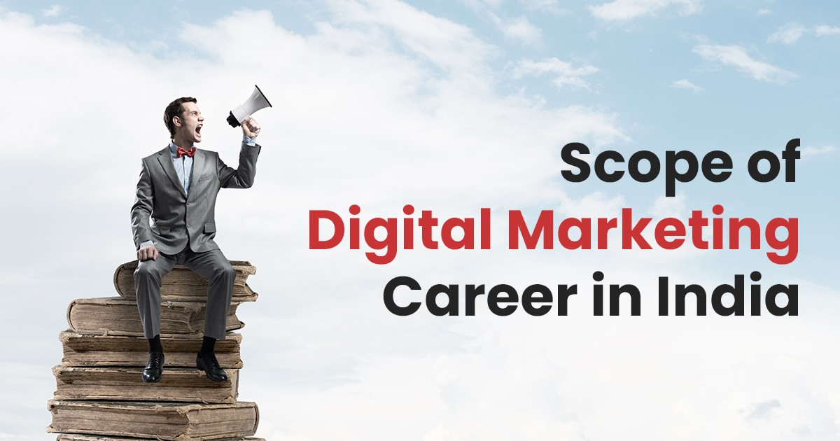
Scope Of Digital Marketing Career in India
By: The Digital Education

Slide 2

B2B -
Companies Utilize Social Media Platforms For Digital Marketing
B2B marketers actively use social media platforms like LinkedIn and Twitter to generate leads
The main focus of B2C marketers is to improve brand awareness and attract new customers to their websites
B2C -

Slide 3
Why Do Companies Use Digital Marketing?
EASILY CAN REACH OUT TO YOUR CUSTOMERS
IT CATERS TO MOBILE PHONE USERS
YOUR COMPETITORS ARE DOING IT
BETTER ROI
COST-EFFECTIVE AND FASTER
ESTABLISH YOUR BRANDS REPUTATION

Slide 4

Methods To Reach Target Audience
01
Paid Search
02
Organic Search
03
Email Marketing Campaigns
04
Content Marketing
05
Webinars
06
Podcast

Slide 5
Why Do Companies Use Digital Marketing?
YOU CAN REACH OUT TO YOUR CUSTOMERS
IT CATERS TO MOBILE PHONE USERS
YOUR COMPETITORS ARE DOING IT
BETTER ROI
COST-EFFECTIVE AND FASTER
ESTABLISH YOUR BRANDS REPUTATION

Slide 6
Future Of Digital Marketing in India
Increasing job opportunities and engagements in digital marketing, we can say that the future of digital marketing is set to be flourishing throughout the world
evolving technologies and more exposure, people are coming up with different and innovative ideas for making the most of digital marketing to grow their businesses
digital marketing also offers the flexibility to work. You can choose to become an influencer, an executive, an SEO analyst, a YouTuber, whatsoever
It enhance the employment rate, but the profiles are highly paid as well

Slide 7
Thank You

